Slide 1



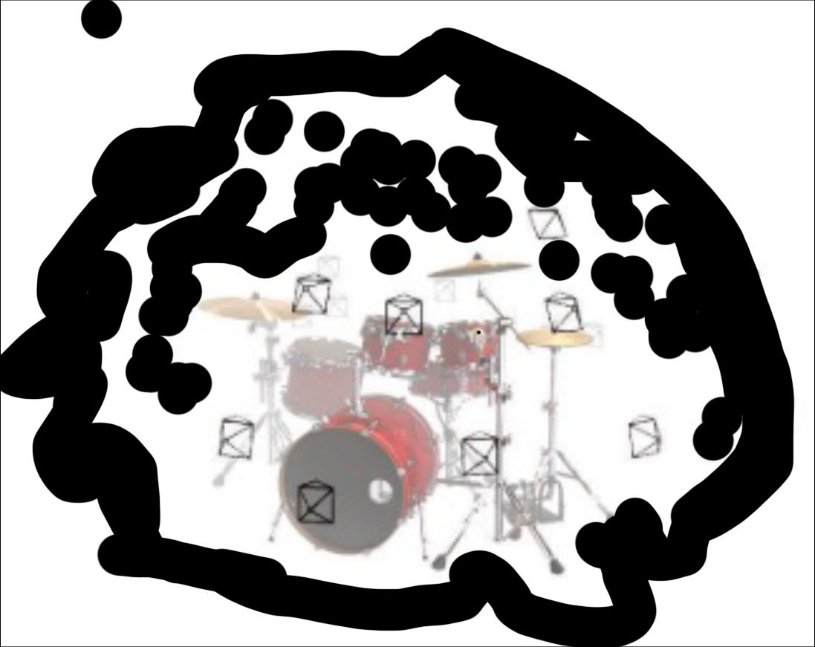
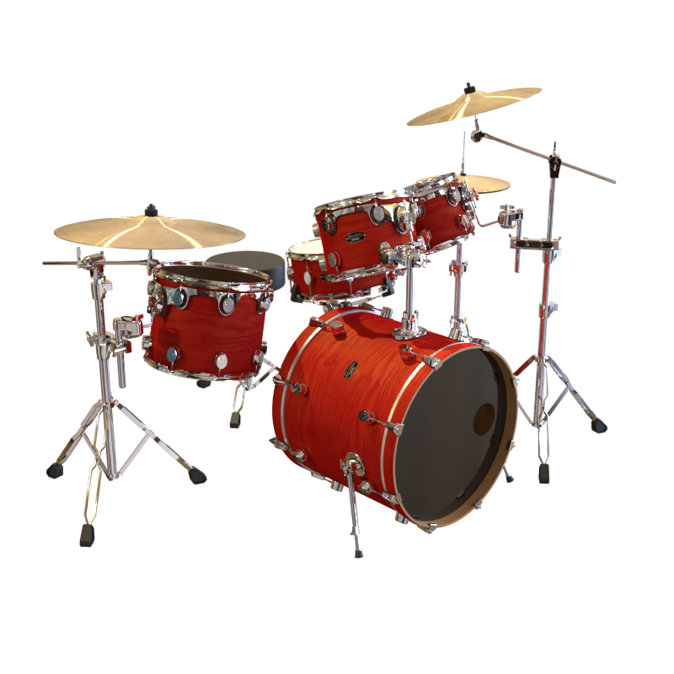
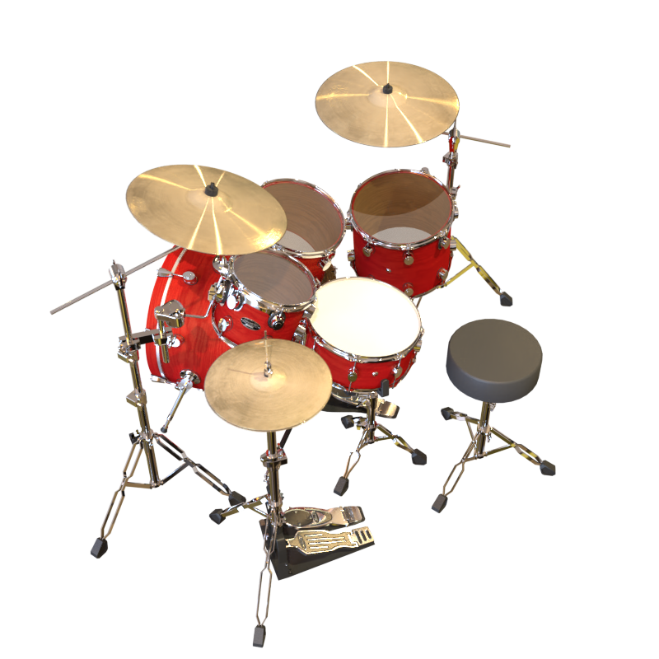
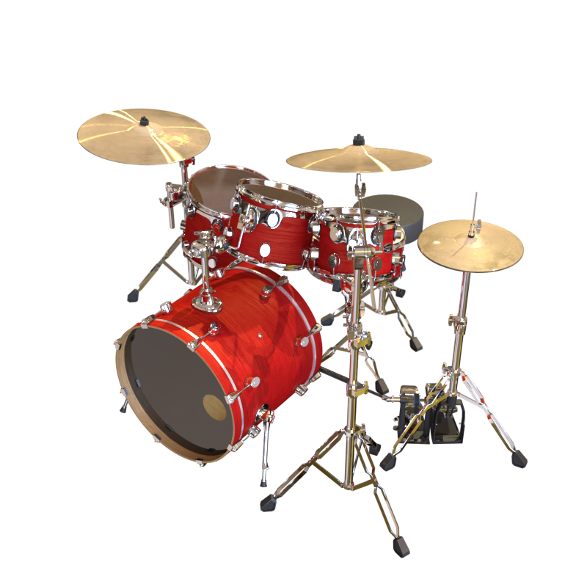
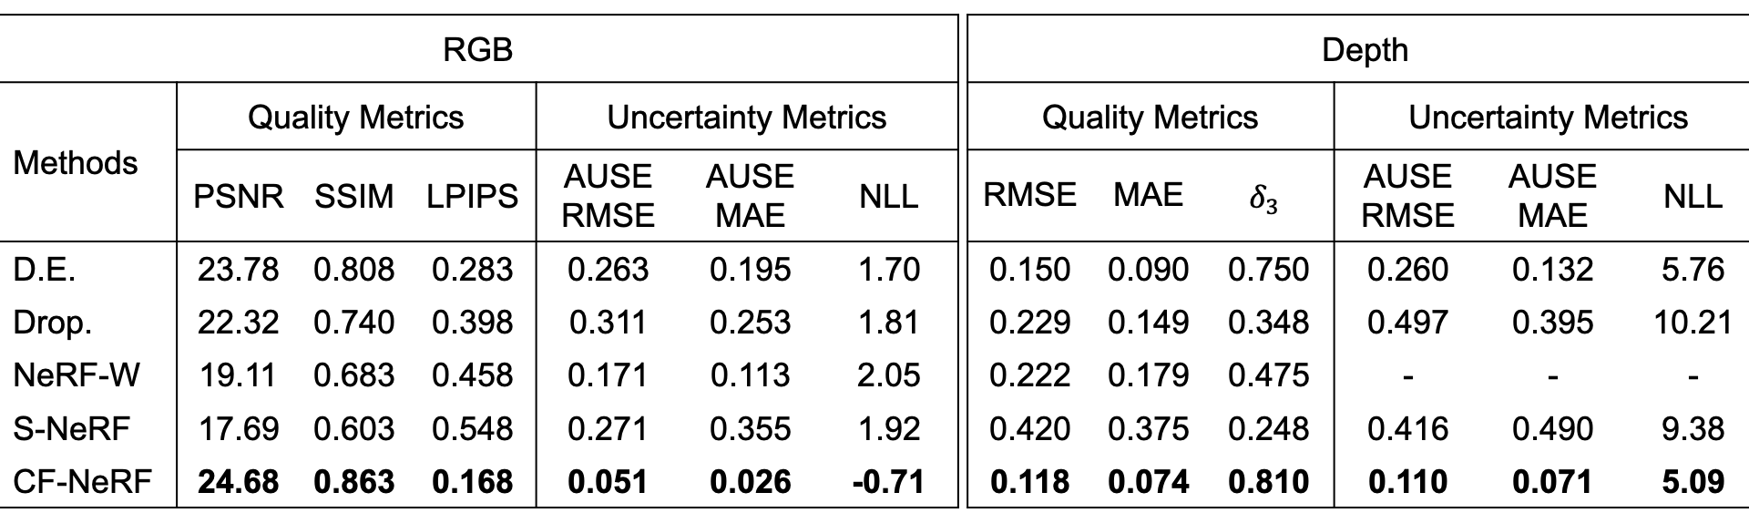
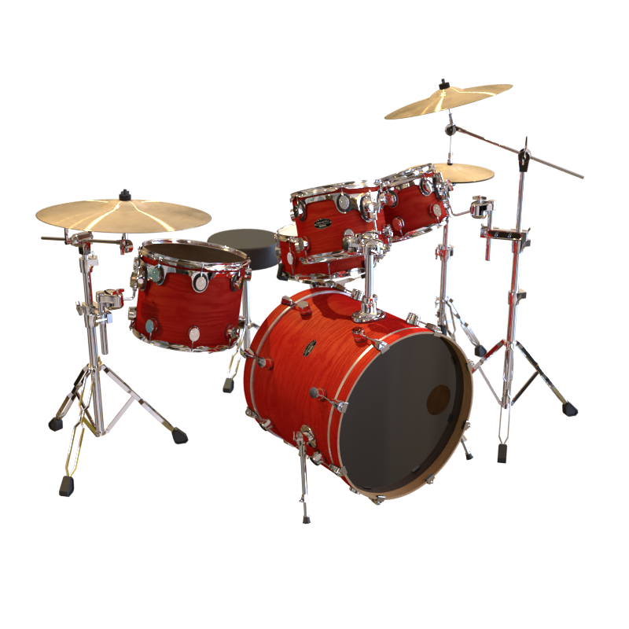
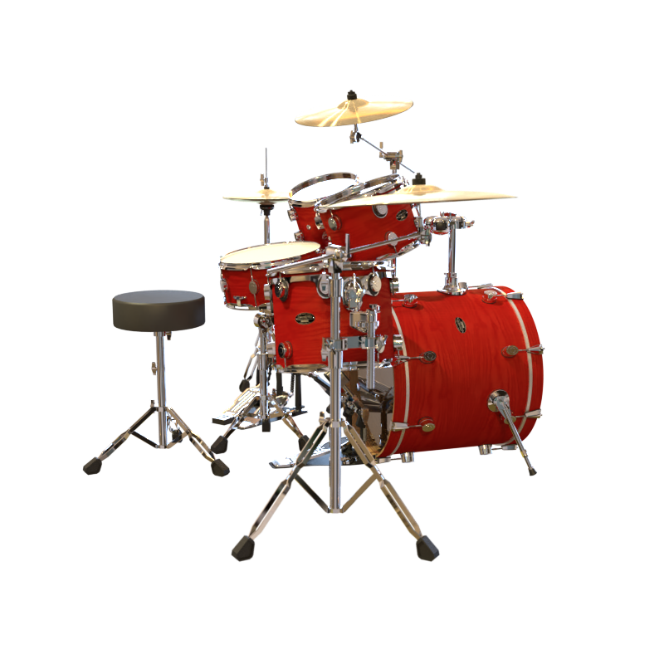
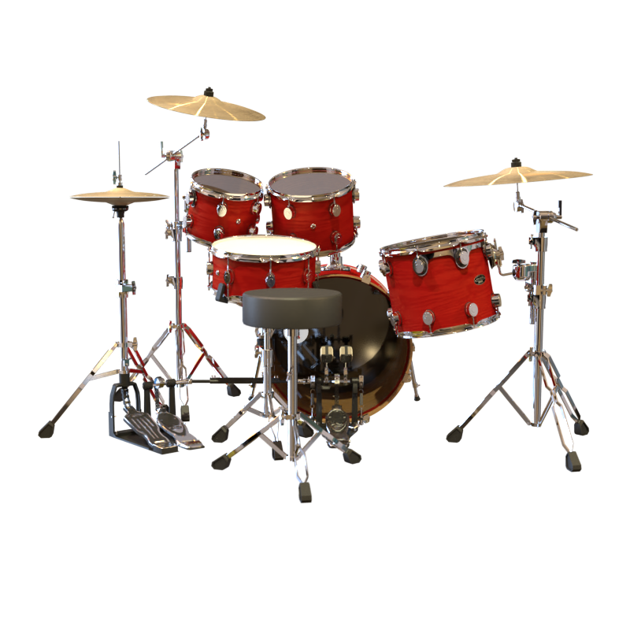
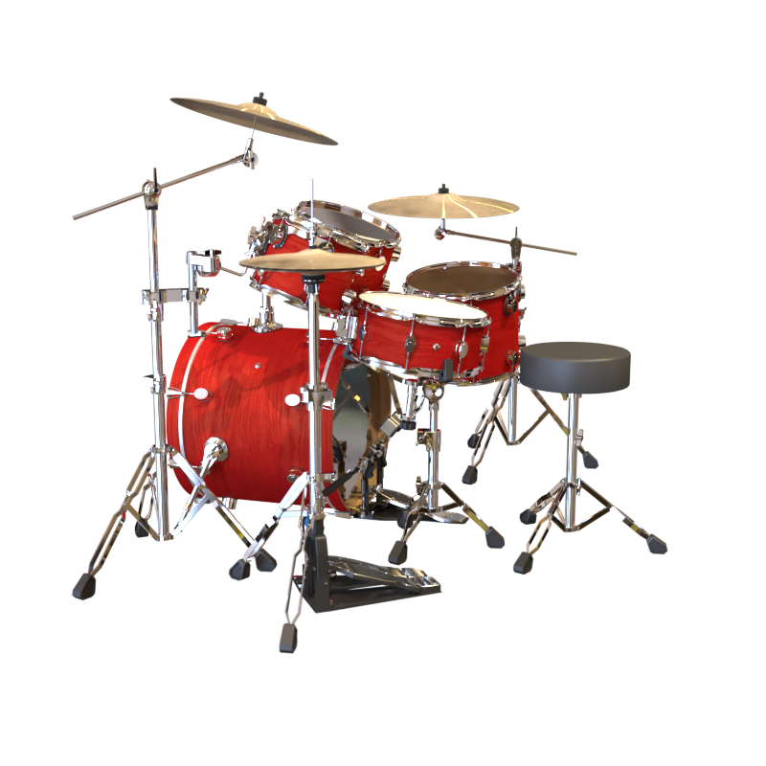
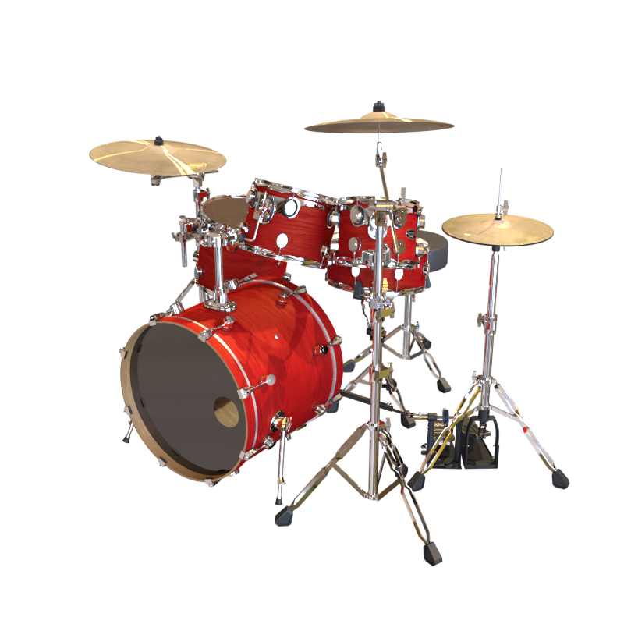

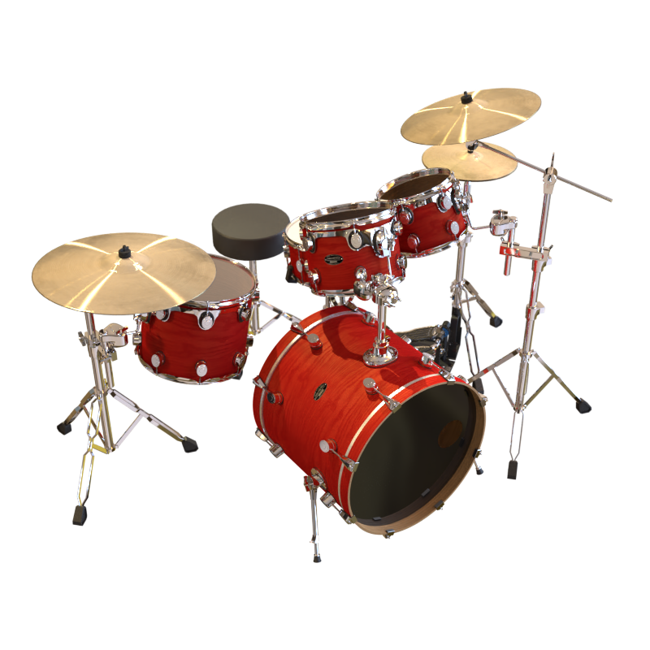
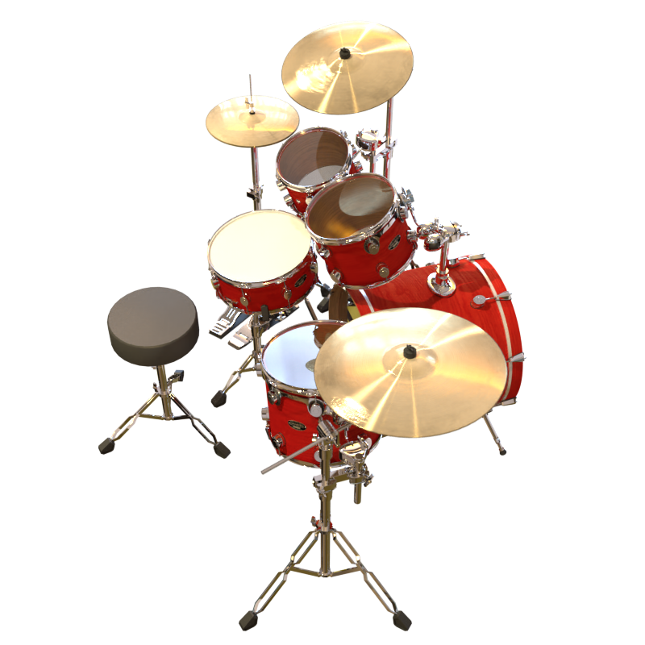
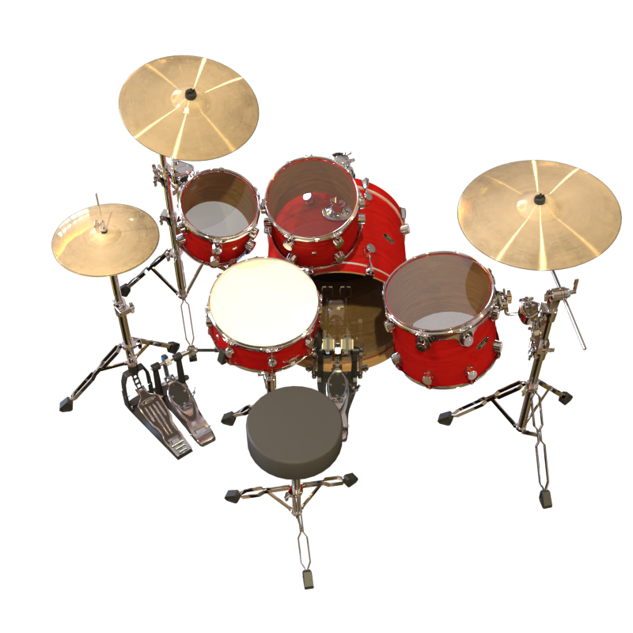

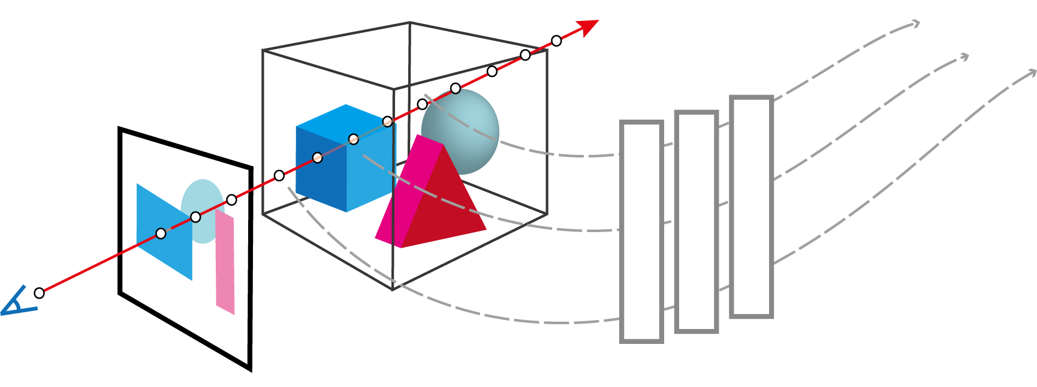
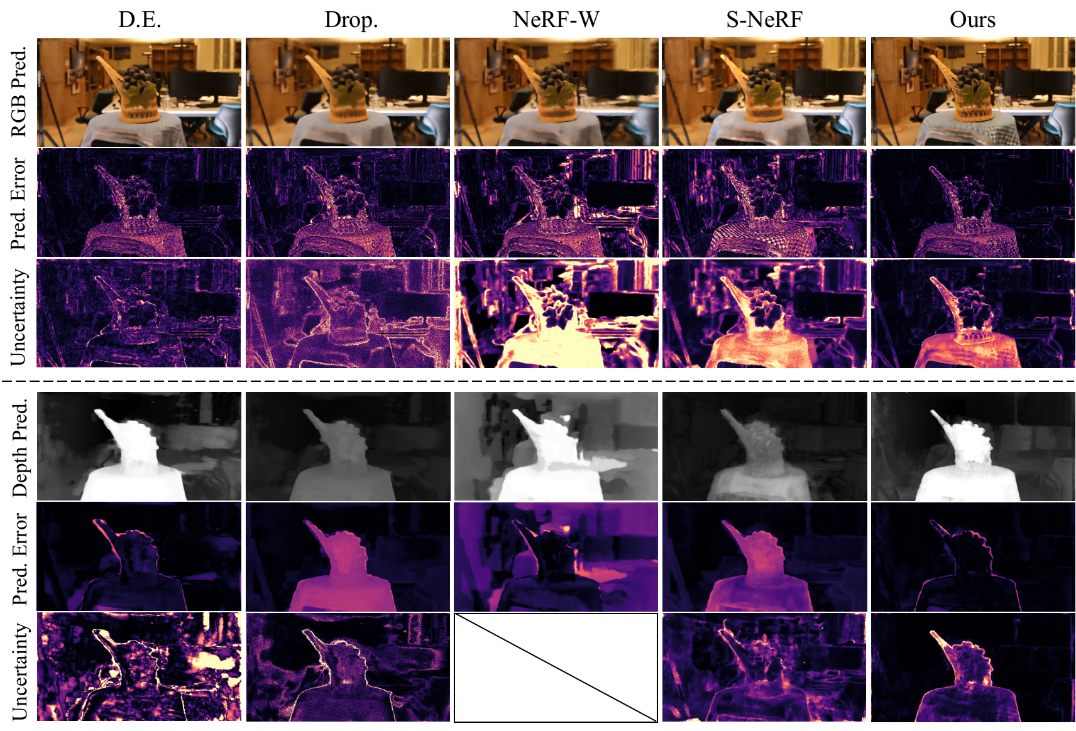
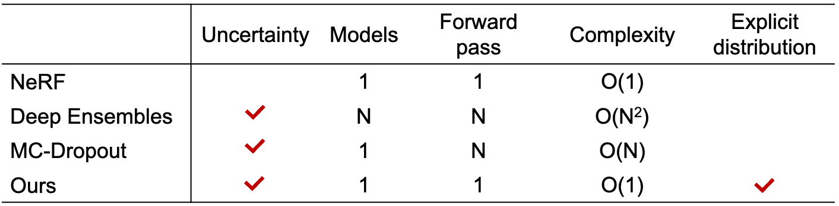
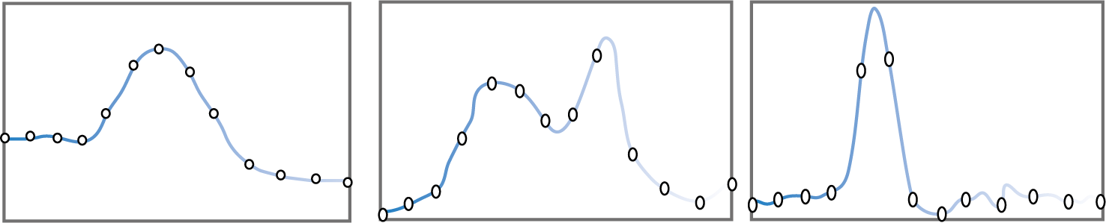
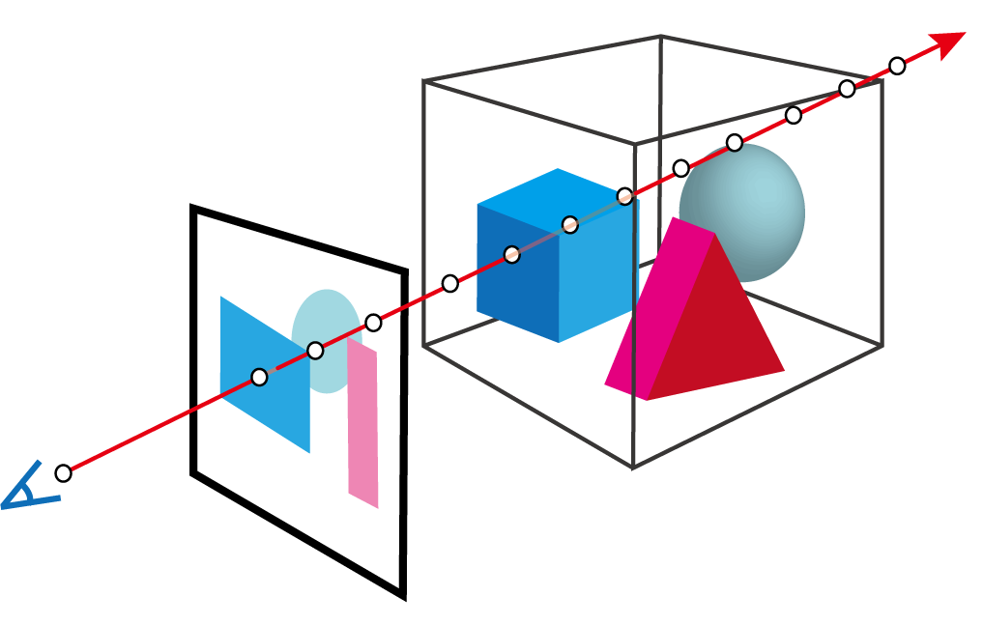
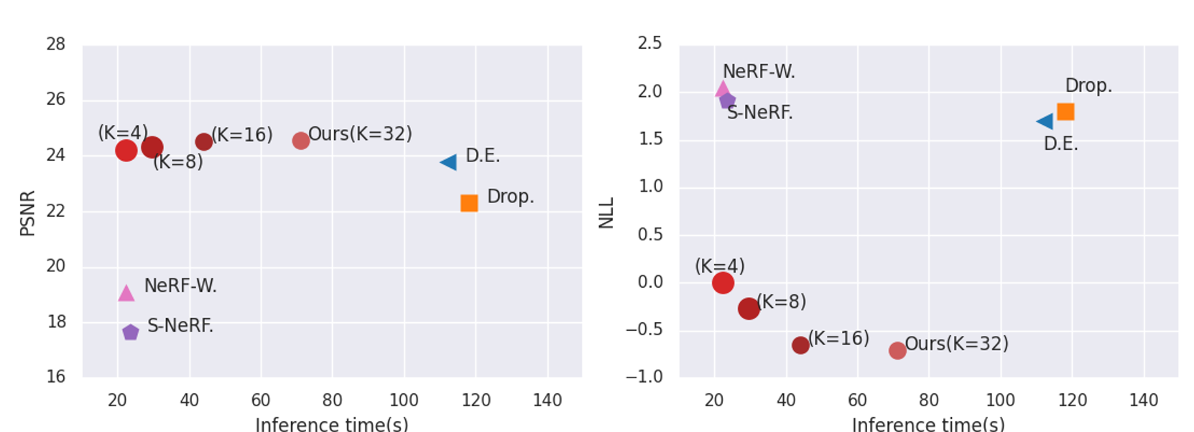
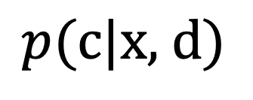
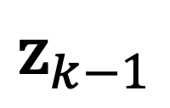
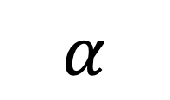
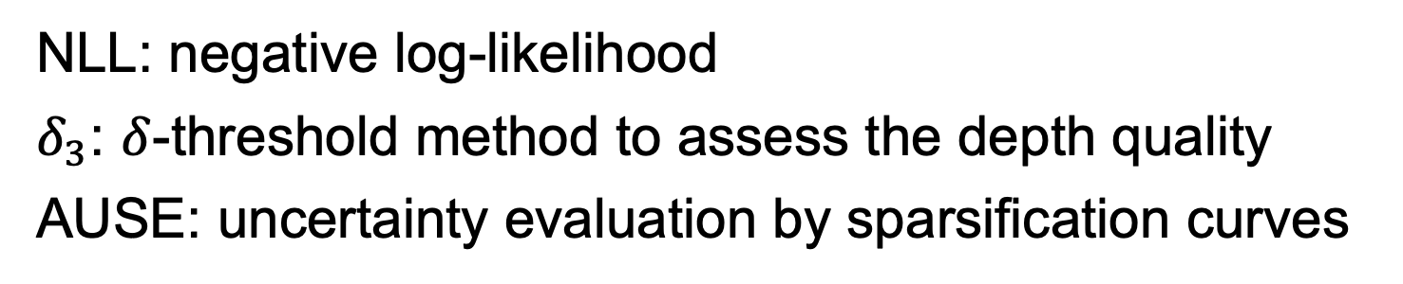
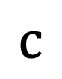
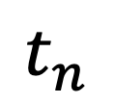
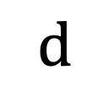
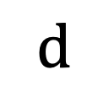
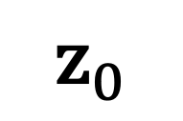
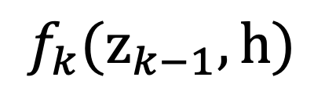
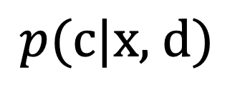
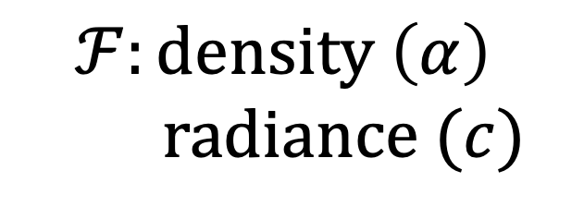
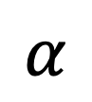
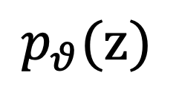
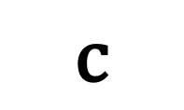
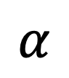
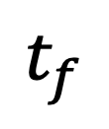
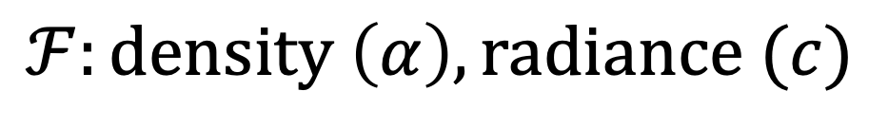
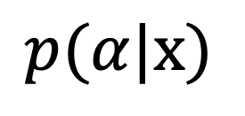
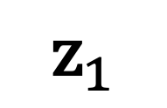
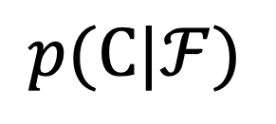
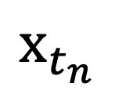
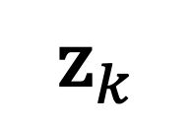
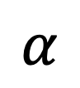
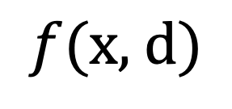
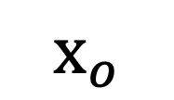
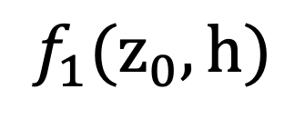
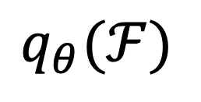
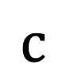
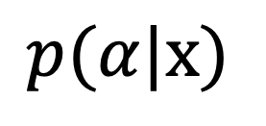
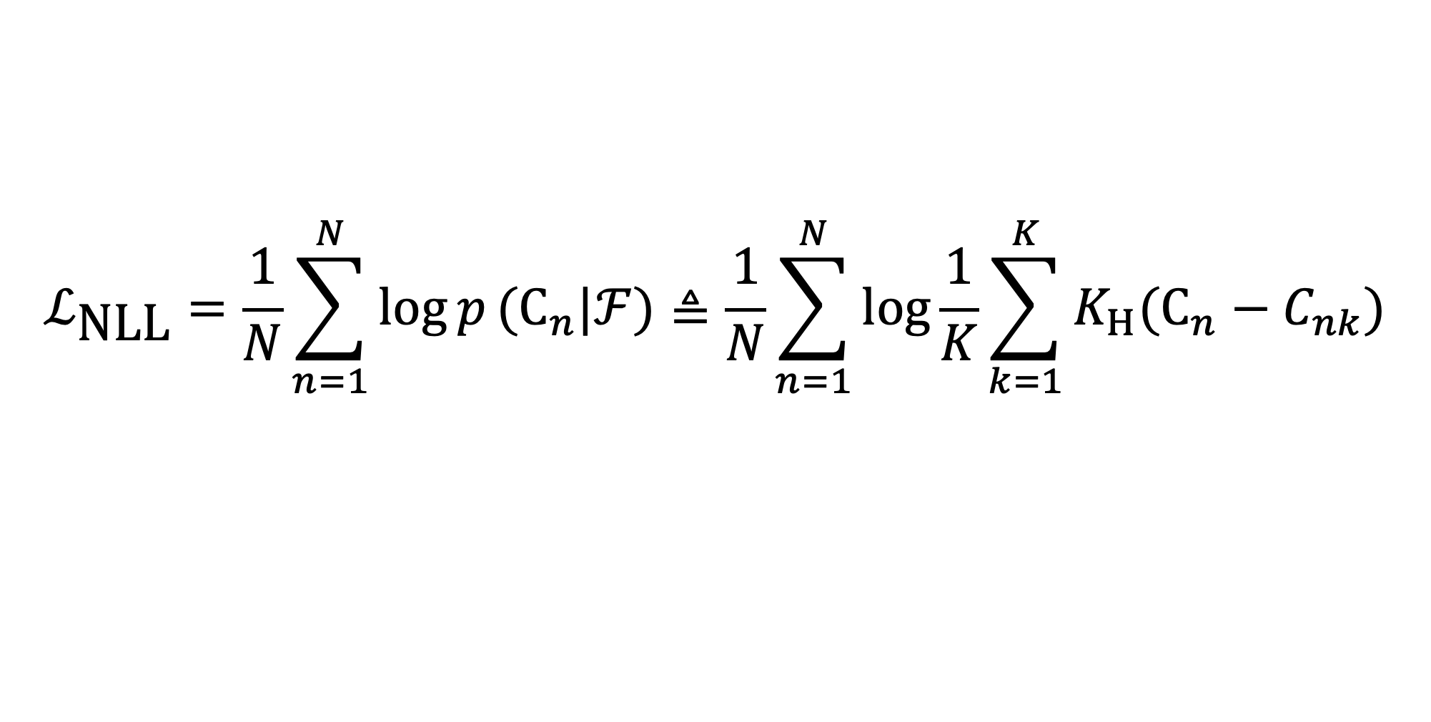

Conditional-Flow NeRF: Accurate 3D Modelling with Reliable Uncertainty Quantification
Jianxiong Shen, Antonio Agudo, Francesc Moreno-Noguer, Adrià Ruiz
https://poetrywanderer.github.io/CF-NeRF/
Introduction
Methodology
Results
Limitation of Neural Radiance Fields (NeRF)
Overall framework
Metrics
NLL: negative log-likelihood
$δ_{3}$: $δ$-threshold method to assess the depth quality
AUSE: uncertainty evaluation by sparsification curves
Sparse images
Optimize NeRF
Render novel views
Latent variable modelling to introduce dependence among all 3D location
Complex distribution modelling by Conditional Normalizing Flow (CNF)
Volume Rendering to build a likelihood for pixel color
Uncertainty estimation on RGB and depth
(a)
global prior
(b)
$$ℱ:\text{density} \left(α\right), \text{radiance} (c)$$
$$p_{θ}(\text{z})$$
CNF
$$q_{θ}(ℱ)$$
Confidence?
Reliable?
$${\text{x}}_{t_{f}}$$
$$\text{d}$$
Model prediction correctness not known
No confidence associated with the model outputs
Could make Risky decisions based on the predictions
$$f(\text{x}\text{, }\text{d})$$
$$p(\text{C}|ℱ)$$
RGB
Pred.
$${\text{x}}_{t_{n}}$$
General Uncertainty Method
Pred.
Error
Pixel-color likelihood
Unc.
$$α$$
Depth
Pred.
(c)
Volume Rendering
Pred.
Error
General uncertainty methods are computationally expensive
Ours model an explicit distribution over all possible radiance fields
$$t_{n}$$
$$t_{f}$$
possible trajectories
Conditional Flow
Unc.
Deterministic VS. Stochastic NeRF
Ours render visually more intuitive uncertainty maps highly correlated with the prediction error both on RGB and depth, as well as more accurate predictions
$$\text{d}$$
$${\text{z}}_{0}$$
$$f_{1}({\text{z}}_{0},h)$$
$${\text{z}}_{1}$$
…
$${\text{z}}_{k−1}$$
$$f_{k}({\text{z}}_{k−1},h)$$
$${\text{z}}_{k}$$
Activation
$$α$$
$$\text{c}$$
$$p(α|\text{x})$$
$$p(\text{c}|\text{x}\text{, }\text{d})$$
Time performance
$$ℱ:\text{density} \left(α\right)$$
$$\text{radiance} (c)$$
h
MLP
$${\text{x}}_{o}$$
Variational Bayesian optimization
PSNR
NLL
KL-divergence:
Deterministic NeRF
Stochastic NeRF
$$\min_{θ}{𝕂𝕃}(q_{θ}\left(ℱ\right)||p\left(ℱ | \text{C}\right))∝\min_{θ}{{−𝔼}_{q_{θ}(ℱ)} \text{log} p\text{(}\text{C}\text{|}ℱ\text{)}+E_{q_{θ}(ℱ)} \text{log} q_{θ}\text{(}ℱ\text{)}}$$
$$α$$
$$\text{c}$$
$$α$$
$$p(α|\text{x})$$
$$\text{c}$$
$$p(\text{c}|\text{x}\text{, }\text{d})$$
log-likelihood (NLL)
Entropy term
Inference time (s)
Inference time (s)
Ours perform the best both on image quality (PSNR) and uncertainty estimation (NLL) with a reasonable inference time
Moreover, properly selecting the number of samples (K=8∼16) reduces the inference time with a negligible impact on performance
To further reduce time usage, our framework can be readily integrated into other efficient NeRF variants like Voxel-based instead of MLP
Kernel density estimator (KDE):
$$ℒ_{\text{NLL}}=\frac{1}{N}\sum_{n=1}^{N}{\log{p}({\text{C}}_{n}|ℱ)}≜\frac{1}{N}\sum_{n=1}^{N}{\log{\frac{1}{K}\sum_{k=1}^{K}{K_{Η}({\text{C}}_{n}−C_{nk})}}}$$
We introduce stochasticity in NeRF for explicitly modelling uncertainty
Gaussian kernel

